Slide 1
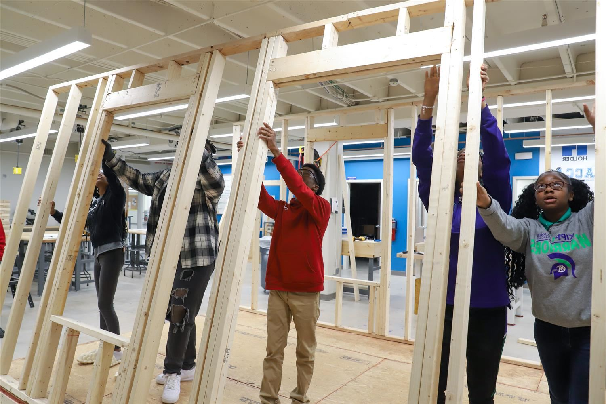
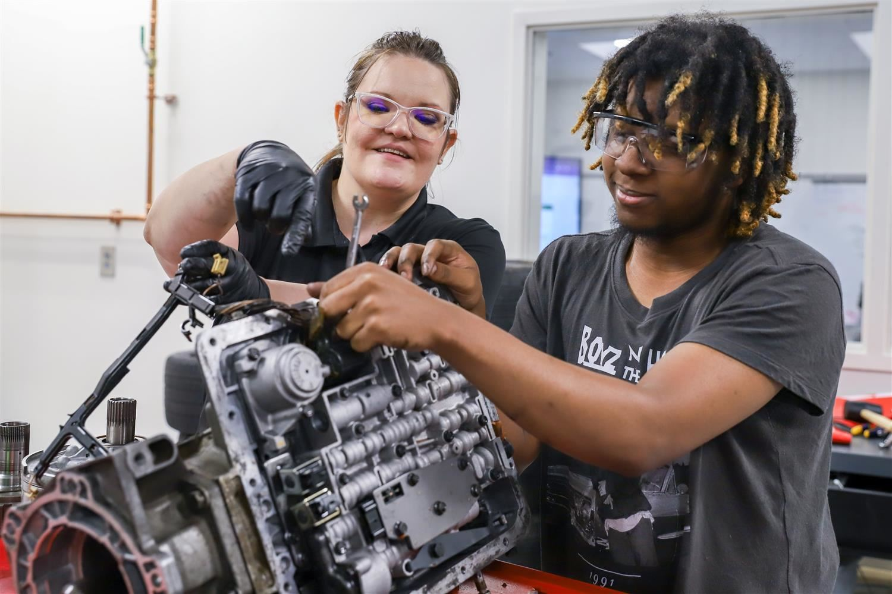
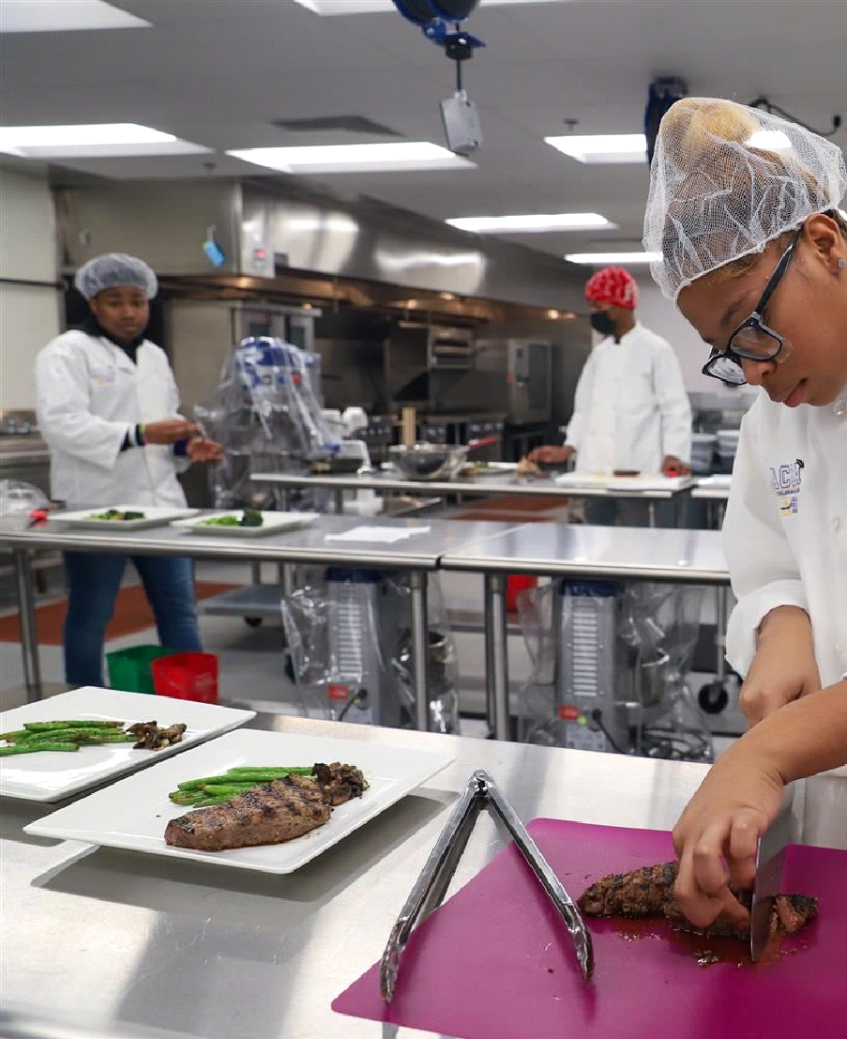
Middle School Career Exposure Camp 2024
June 3rd – 14th

Slide 2
ACCA Career Exposure Camp For Middle School Scholars (Current 6th – 8th Graders)
Introduction and Overview
Video Presentation and Pathway Offerings
Bell Schedule and Weekly Activities
Transportation and Nutrition
Registration and Orientation
Q&A

Slide 3
What is ACCA?
The Atlanta College and Career Academy (ACCA) is a program provided by Atlanta Public Schools to help students graduate with credentials aligned to high demand technical careers in Atlanta.
Students are eligible to enroll in our pathways during their 10th – 12th years.
Notes:
This slide gives an overview of what the Atlanta College and Career Academy is.
We are a program provided by Atlanta Public Schools to help students graduate with credentials aligned to high demand technical careers in Atlanta.
High school students are eligible to enroll in our pathways during their 10th – 12th years.

Slide 4
Why Scholars Attend ACCA?
Notes:
This video highlights some of the pathways offered on our campus and provides some insight to the experience middle school students will have this summer.

Slide 5
New Opportunities For Middle School
Notes:
Hopefully, you enjoyed the video and have a better understanding of the opportunity that awaits you as a participant in our first annual ACCA Career Exposure Camp for Middle School students.

Slide 6
ACCA Career Exposure Camp 2024
June 3rd – 14th - Monday – Friday from 9:30am – 3:30pm
Career Pathways
Criminal Investigation
Culinary Arts
Dental Science
Graphic Design
Patient Care
Students will select two pathways per week and will be assigned to one pathway in the morning and a second pathway in the afternoon.
Notes:
ACCA’s Career Exposure Camp 2024 is a week-long enrichment program for current 6th – 8th grade scholars in Atlanta Public Schools. During the program, students will gain exposure to high demand/high wage careers in the Metro-Atlanta area and a general understanding that postsecondary education and lifelong learning are necessary for long-term success.
The program will take place June 3rd – 14th Monday – Friday from 9:30am to 3:30pm.
The program will accept 100 students per week.
Each pathway can accommodate up to 40 students per week.
Morning sessions will accommodate 20 students per pathway
Afternoon session will accommodate 20 students per pathway.

Slide 7
ACCA Career Exposure Camp Sample Schedule
Tentative Bell Schedule
2 Class Rotations 9:30 – 12:30 and 12:30 to 3:30
(30 Minute Lunch Break)
Staff arrival 8:45 a.m.
Student Arrival/Breakfast 9 - 9:30 a.m.
Career Pathway 1 9:30am – 12:30 p.m.
A Lunch 11:30 pm – 12:00 pm – 1st Floor
B Lunch 12:00 pm – 12:30 pm –2nd Floor
Career Pathway 2 12:30pm – 3:30 p.m.
Student Dismissal 3:30 p.m.
Staff Departure 3:45 p.m.
Notes:
This is a sample bell schedule for the program.
Students will attend two classes per day with a 30-minute lunch break between the sessions.
In the morning, students will receive transportation from their home to the clusters designated summer school site for Middle School. Students will transition to a shuttle bus that will bring them to ACCA round trip. Students will return back to their designated summer school site to ride the cluster bus back home.

Slide 8
ACCA Career Exposure Camp Sample Weekly Activities
Monday – Overview and Safety
Tuesday – Field Trip – Morning Pathway
Wednesday – Career Day at ACCA
Guest speakers, and possible Career Inventory or YouScience interpretation
Thursday – Field Trip – Afternoon Pathway
Friday – Culminating Activity
Tentative Tour sites: Le Cordon Bleu, Augusta Dental School, Center For Disease Control, Mercedes Benz Stadium, Fulton County Court House
Notes:
This is a sample schedule of the weekly activities.
Monday – Overview and Safety
Tuesday – Field Trip – Morning Pathway
Wednesday – Career Day at ACCA
Guest speakers, and possible Career Inventory or YouScience interpretation
Thursday – Field Trip – Afternoon Pathway
Friday – Culminating Activity
Tentative Tour sites: Le Cordon Bleu for culinary arts, Augusta Dental School for dental science, Center For Disease Control for patient care, Mercedes Benz Stadium for Graphic Design, and the Fulton County Court House for Criminal Investigations

Slide 9
ACCA Career Exposure Camp Tentative Transportation
Week 1 – June 3rd – 7th | Week 2 – June 15th – 19th
Sylvan Middle – Long pick up | Bunche Middle – Bunche pick up
Long Middle – Long pick up | Young Middle – Bunche pick up
King Middle – Howard pick up | John Lewis Middle - JLI pick up
Howard Middle – Howard pick up | Russell Middle – Russell pick up
 | CSK and BEST – JLI pick up
 | Sutton Middle – Sutton pick up
** Students may register for both weeks. However, parents/guardians will be required to provide transportation to and from ACCA outside the targeted enrollment week.
*** Students from Charter and Partner School may attend either week and will be required to provide their own transportation to and from ACCA both weeks.
Notes:
This is the tentative transportation schedule. Transportation will be provided for targeted schools each week.
Students may register for both weeks. However, parents/guardians will be required to provide transportation to and from ACCA outside the targeted enrollment week.
For example, a Sylvan Middle school student may attend the program during week 1 and week 2. However, APS will only provide transportation for week 1 since that is the targeted enrollment week. The parent/guardian will be responsible for transportation since the student is attending outside the targeted week.
Please note that transportation is only provided for students from traditional schools. Students from Charter and Partner School may attend either week and will be required to provide their own transportation to and from ACCA both weeks.
Parents/guardians from traditional APS schools may also provide daily transportation if they do not want their scholar to ride an APS bus.

Slide 10
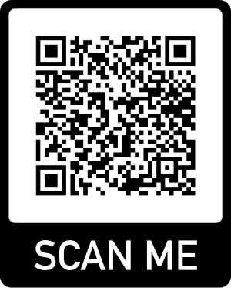
Extended Application Deadline
April 10, 2024
Click Here To Access The
ACCA Career Exposure Camp 2024 Application
Notes:
https://docs.google.com/forms/d/e/1FAIpQLSfUjY0NkbxPF2fn2Y9602m_NI0CHV2klITyZI5tCncUrIGTvA/viewform?usp=sf_link
Finally, this slide has the link to register for the Middle School Career Exposure camp. We hope that you are excited about this opportunity and will plan to join us this summer.
The extended application deadline is Wednesday, April 10th and we will send enrollment verifications by Friday, April 12th.
Students will be assigned on a first come first serve basis with priority placement for scholars to attend during their targeted weeks.
Thank you for joining the session. Now, I will open the discussion for questions?

Slide 11
QUESTIONS?

